Slide 1














Home Credit Score Card Model
Presented by Rafif Nauval Tuah Siregar

Slide 2
PROBLEM RESEARCH

Slide 3

Background
Home Credit is dedicated to expanding financial inclusion by offering a positive and secure lending experience for individuals who often face difficulties in accessing loans due to limited or no credit history. Recognizing the importance of ensuring a favorable lending experience for these underserved individuals, Home Credit uses various alternative data sources to assess the repayment ability of its customers. By utilizing these alternative data sources, Home Credit aims to accurately evaluate the financial capability of its customers, minimizing the risk of rejecting deserving applicants while tailoring the loan terms, loan amount, maturity period, and repayment schedule to suit the customer's circumstances. This approach not only facilitates access to much-needed financial resources, but also empowers customers to manage their loans well and achieve their financial goals.
Problem
Objective
Home Credit aims to develop a machine learning system to assist the team in ascertaining the approval or rejection status of loan proposals. Furthermore, by analyzing the available data, HCI seeks to identify customer criteria that are often associated with approved loans, so as to determine the next target market.
1. Identify the characteristics of prospective clients who will have difficulty repaying loans and who will not
2. predicting the client's repayment ability

Slide 4
BUSINESS INSIGHT

Slide 5
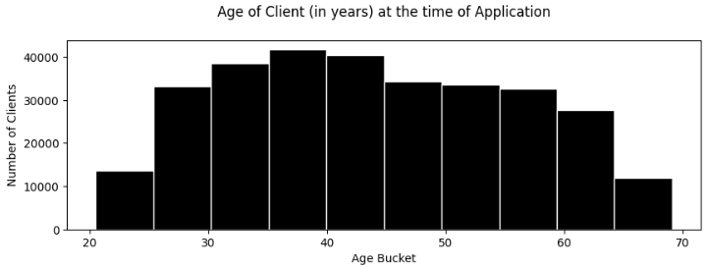
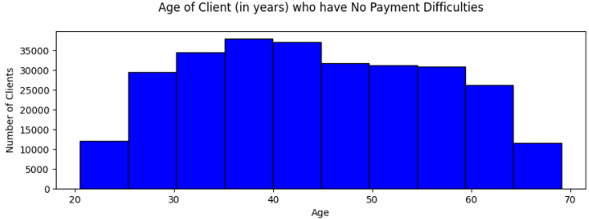
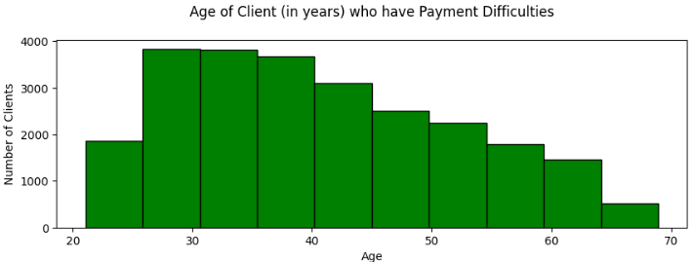
01.
It can be seen that the customers who apply for the most loans are customers in the age range of 35-40 years, while the fewest loans are customers who are under the age of 25 and over 65 years.
customers who do not have difficulty paying are in the age range 35-40 years. while customers who have the most difficulty paying are in the age range 25-35 years.
02.

Slide 6
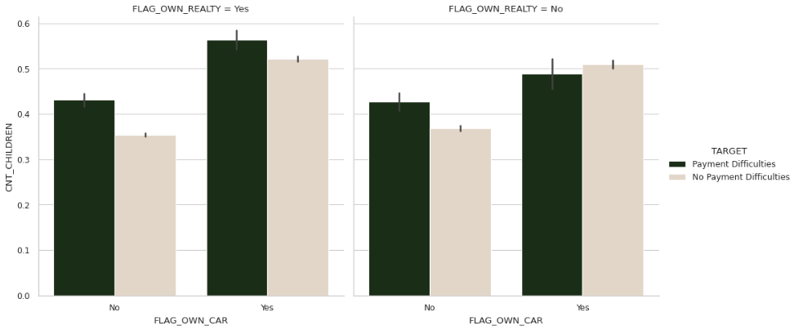
Clients who own a car and a house/flat have a problem repaying the loans for a high number of children compared to clients who do not own houses/flat.
03.

Slide 7
MACHINE LEARNING MODEL

Slide 8
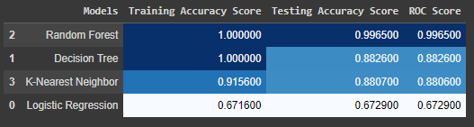
Model Comparisson
The prediction accuracy of the train and test data in Random Forest model has a value that is not much different, it can be said that the model is very good, which is there is no underfitting or overfitting. So the Random Forest model was chosen as the best model to predict client’s repayment abilities

Slide 9
BUSINESS RECOMENDATION

Slide 10
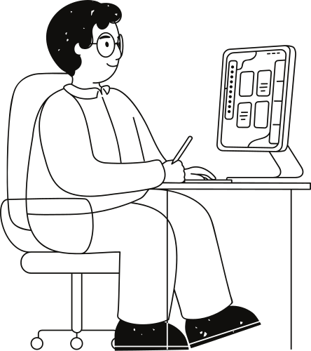
After analyzing and finding data on the age ranges that have loan repayment problems, I can recommend that Home Credit may consider segmenting the market by age range. They can offer different products and services for customers aged 25-35 years old and 35-40 years old, according to different repayment risk characteristics.
01.
After analyzing and finding data that customers who own cars and houses/apartments have problems repaying their loans due to more children, I can recommend that Home Credit may consider developing loan products tailored to the needs of this group of customers. For example, they could offer more flexible repayment plans or longer loan terms to help accommodate the financial needs of families with more children.
02.

Slide 11
Thank you very much!
For the entire Project:
https://github.com/RafifNauval12/Home-Credit-Score-Card-Model

